Slide 1
Chapter 10: Virtual Memory

Slide 2
Chapter 10: Virtual Memory
Background
Virtual Memory
Demand Paging
Page Replacement
Page and Frame Replacement Algorithms

Slide 3
Background
Code needs to be in memory to execute, but entire program rarely used
Error code, unusual routines, large data structures
Entire program code not needed at same time
Consider ability to execute partially-loaded program
Program no longer constrained by limits of physical memory
Each program takes less memory while running -> more programs run at the same time
Increased CPU utilization and throughput with no increase in response time or turnaround time
Less I/O needed to load or swap programs into memory -> each user program runs faster

Slide 4
Virtual memory
Virtual memory – separation of user logical memory from physical memory
Only part of the program needs to be in memory for execution
Logical address space can therefore be much larger than physical address space
Allows address spaces to be shared by several processes
Allows for more efficient process creation
More programs running concurrently
Less I/O needed to load or swap processes

Slide 5
Virtual memory (Cont.)
Virtual address space – logical view of how process is stored in memory
Usually start at address 0, contiguous addresses until end of space
Meanwhile, physical memory organized in page frames
MMU must map logical to physical
Virtual memory can be implemented via:
Demand paging
Demand segmentation

Slide 6
Demand Paging
Could bring entire process into memory at load time
Or bring a page into memory only when it is needed
Less I/O needed, no unnecessary I/O
Less memory needed
Faster response
More users
Similar to paging system with swapping (diagram on right)
Page is needed ⇒ reference to it
invalid reference ⇒ abort
not-in-memory ⇒ bring to memory
Lazy swapper – never swaps a page into memory unless page will be needed
Swapper that deals with pages is a pager

Slide 7
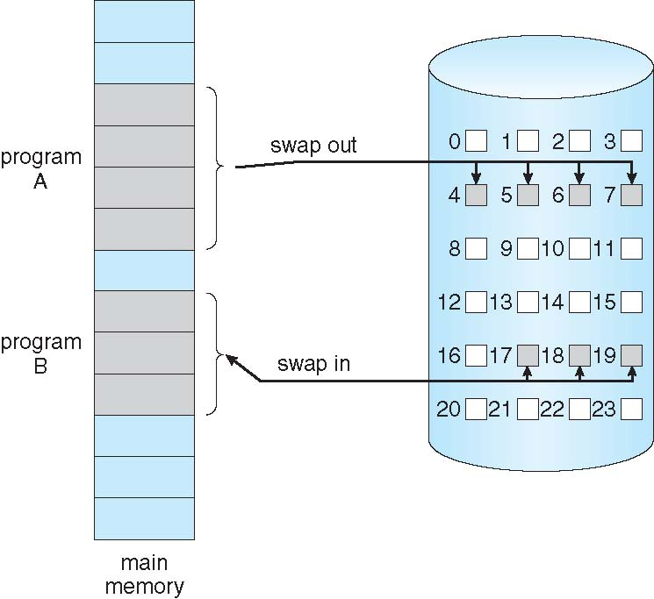
Demand Paging
Could bring entire process into memory at load time
Or bring a page into memory only when it is needed
Less I/O needed, no unnecessary I/O
Less memory needed
Faster response
More users
Similar to paging system with swapping (diagram on right)

Slide 8
What Happens if There is no Free Frame?
Used up by process pages
Also in demand from the kernel, I/O buffers, etc
How much to allocate to each?
Page replacement – find some page in memory, but not really in use, page it out
Algorithm – terminate? swap out? replace the page?
Performance – want an algorithm which will result in minimum number of page faults
Same page may be brought into memory several times

Slide 9
Page Replacement
Prevent over-allocation of memory by modifying page-fault service routine to include page replacement
Use modify (dirty) bit to reduce overhead of page transfers – only modified pages are written to disk
Page replacement completes separation between logical memory and physical memory – large virtual memory can be provided on a smaller physical memory

Slide 10
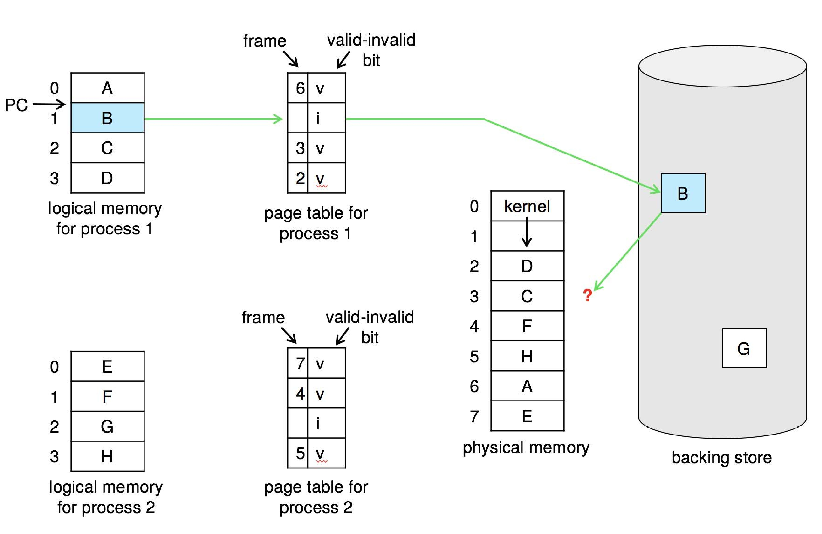
Need For Page Replacement

Slide 11
Basic Page Replacement
Find the location of the desired page on disk
Find a free frame: - If there is a free frame, use it - If there is no free frame, use a page replacement algorithm to select a victim frame - Write victim frame to disk if dirty
Bring the desired page into the (newly) free frame; update the page and frame tables
Continue the process by restarting the instruction that caused the trap
Note now potentially 2 page transfers for page fault – increasing EAT

Slide 12
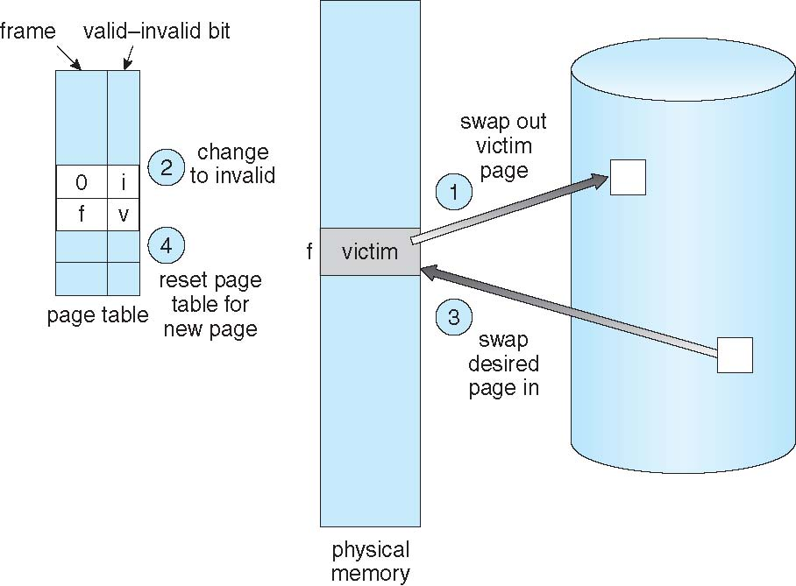
Page Replacement

Slide 13
Page and Frame Replacement Algorithms
Frame-allocation algorithm determines
How many frames to give each process
Which frames to replace
Page-replacement algorithm
Want lowest page-fault rate on both first access and re-access
Evaluate algorithm by running it on a particular string of memory references (reference string) and computing the number of page faults on that string
String is just page numbers, not full addresses
Repeated access to the same page does not cause a page fault
Results depend on number of frames available
In all our examples, the reference string of referenced page numbers is
7,0,1,2,0,3,0,4,2,3,0,3,0,3,2,1,2,0,1,7,0,1

Slide 14
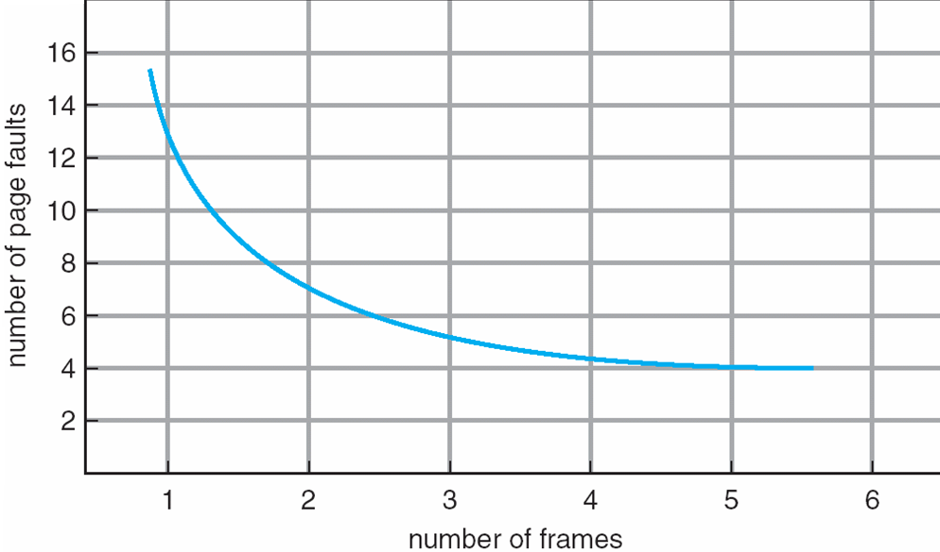
Graph of Page Faults Versus the Number of Frames

Slide 15
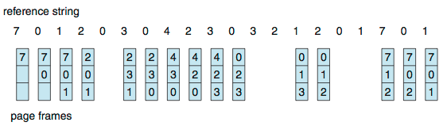
First-In-First-Out (FIFO) Algorithm
Reference string: 7,0,1,2,0,3,0,4,2,3,0,3,0,3,2,1,2,0,1,7,0,1
3 frames (3 pages can be in memory at a time per process)
Can vary by reference string: consider 1,2,3,4,1,2,5,1,2,3,4,5
Adding more frames can cause more page faults!
Belady’s Anomaly
How to track ages of pages?
Just use a FIFO queue
15 page faults

Slide 16
FIFO Illustrating Belady’s Anomaly

Slide 17
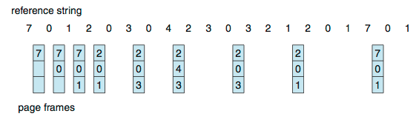
Optimal Algorithm
Replace page that will not be used for longest period of time
9 is optimal for the example
How do you know this?
Can’t read the future
Used for measuring how well your algorithm performs

Slide 18
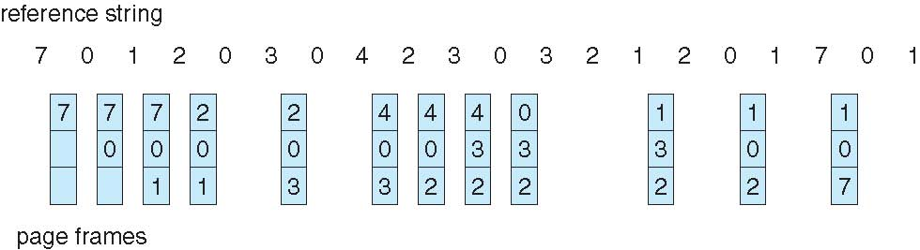
Least Recently Used (LRU) Algorithm
Use past knowledge rather than future
Replace page that has not been used in the most amount of time
Associate time of last use with each page
12 faults – better than FIFO but worse than OPT
Generally good algorithm and frequently used
But how to implement?

Slide 19
LRU Algorithm (Cont.)
Counter implementation
Every page entry has a counter; every time page is referenced through this entry, copy the clock into the counter
When a page needs to be changed, look at the counters to find smallest value
Search through table needed
Stack implementation
Keep a stack of page numbers in a double link form:
Page referenced:
move it to the top
requires 6 pointers to be changed
But each update more expensive
No search for replacement

Slide 20
LRU Algorithm (Cont.)
LRU and OPT are cases of stack algorithms that don’t have Belady’s Anomaly
Use Of A Stack to Record Most Recent Page References

Slide 21
LRU Approximation Algorithms
LRU needs special hardware and still slow
Reference bit
With each page associate a bit, initially = 0
When page is referenced bit set to 1
Replace any with reference bit = 0 (if one exists)
We do not know the order, however

Slide 22
LRU Approximation Algorithms (cont.)
Second-chance algorithm
Generally FIFO, plus hardware-provided reference bit
Clock replacement
If page to be replaced has
Reference bit = 0 -> replace it
reference bit = 1 then:
set reference bit 0, leave page in memory
replace next page, subject to same rules

Slide 23
Second-chance Algorithm

Slide 24
Enhanced Second-Chance Algorithm
Improve algorithm by using reference bit and modify bit (if available) in concert
Take ordered pair (reference, modify):
(0, 0) neither recently used not modified – best page to replace
(0, 1) not recently used but modified – not quite as good, must write out before replacement
(1, 0) recently used but clean – probably will be used again soon
(1, 1) recently used and modified – probably will be used again soon and need to write out before replacement
When page replacement called for, use the clock scheme but use the four classes replace page in lowest non-empty class
Might need to search circular queue several times

Slide 25
Counting Algorithms
Keep a counter of the number of references that have been made to each page
Not common
Lease Frequently Used (LFU) Algorithm:
Replaces page with smallest count
Most Frequently Used (MFU) Algorithm:
Based on the argument that the page with the smallest count was probably just brought in and has yet to be used

Slide 26
End of Chapter 10

